Slide 1


Demand Forecasting in Supply Chain
Final Presentation
April 25 - 2025
Team008 Capstone Project

Slide 2
Outline
Problem Statement
Model:
Model selection
Model prediction
Testing model responsiveness to NASDAQ changes
EDA

Slide 3

Problem Statement
Effective demand forecasting is crucial for maintaining optimal inventory levels and ensuring timely deliveries. However, discrepancies between customer forecasts and actual demand often lead to stock imbalances, causing overstocking or stockouts. These inefficiencies increase costs, strain supplier relationships, and impact customer satisfaction. Variations in demand data create challenges in inventory planning across customers, parts, hubs, and suppliers, affecting overall stock availability.

Slide 4
Project Scope
Goals Related To Forecasting Errors
The project aims to identify critical forecasting errors and their repercussions on inventory levels, providing insights for improvement.
Enhancing Supply Chain Efficiency
Recommendations will focus on improving forecasting accuracy and optimizing supply chain operations to reduce inefficiencies.

Slide 5

Business Values This project enhances demand forecasting accuracy, reduces inventory imbalances, and improves overall supply chain efficiency.
Optimized Inventory Management
Aligning planned and actual demand minimizes stock shortages and excess inventory, leading to better resource utilization and cost efficiency.
Improved On-Time Delivery
More accurate forecasting helps bridge fulfillment gaps, ensuring timely deliveries, strengthening supplier relationships, and increasing customer satisfaction.

Slide 6
Assumptions
Historical Data Validity
Stability Of Demand Patterns
Impact Of Forecasting Errors
Assuming that historical data is usable despite some disturbances, we will apply data cleaning and statistical techniques.
We consider firm demand patterns to be generally stable, with occasional short deviations.
Assumed that errors significantly influence inventory levels and on-time delivery, underpinning the need for accurate forecasting methods.

Slide 7
Data Preparation Summary
Data used to train the model :
Historical file 2023~2024 (one year)
No missing values
Keep duplicates
Removed year 2022, 2026,2027 from the data
20,587rows of data

Slide 8
EDA

Slide 9
Historical Insights
Total Shipment Quantity
Total Material ID
920
67.84 M
Year of data used: 2023~2024

Slide 10
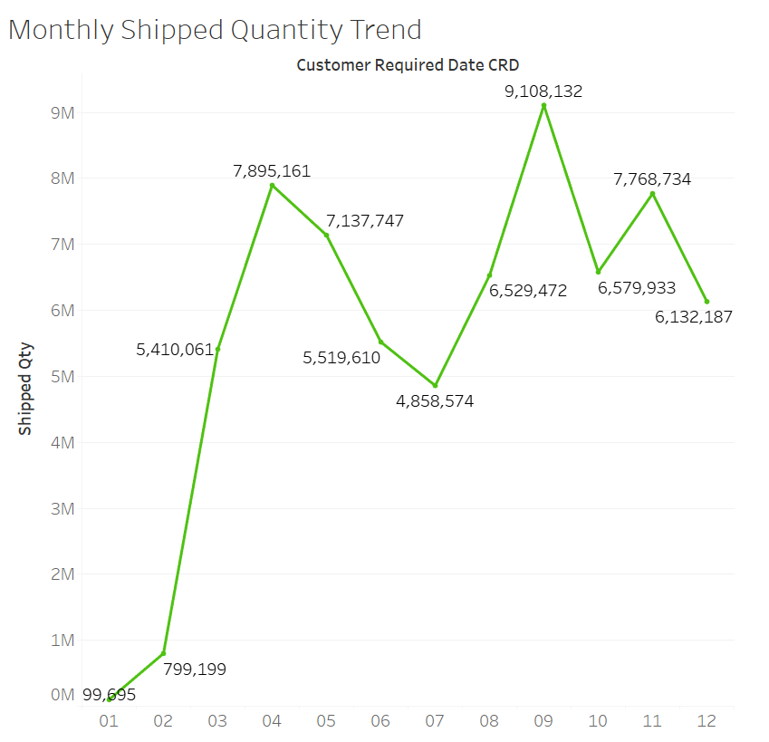
Historical Insights
Monthly Shipped Quantity Trend
Irregular customer demand or delivery scheduling
After October, the overall volume slightly declined
Notes:
中文版：
從3月開始，出貨量迅速上升並且維持在高檔，但每週的出貨量波動劇烈，顯示客戶需求或排程有不規則的高低起伏。10月後出貨量略微下降，但整體震盪型態仍然持續。
英文版：
Starting from March, the shipment volume surged rapidly and maintained a high level with significant week-to-week fluctuations, indicating irregular customer demand or delivery scheduling. After October, the overall volume slightly declined, but the fluctuation pattern persisted.

Slide 11
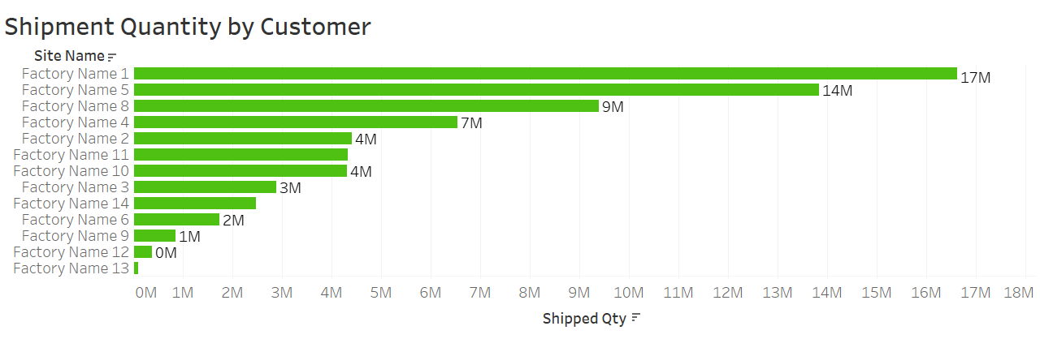
Historical Insights
Shipment Quantity by Customer
Top 3 Customer : 1、5、8

Slide 12
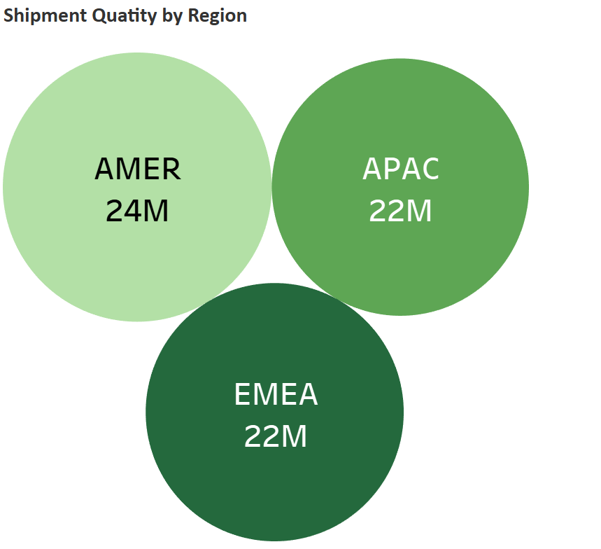
2000
SG14
Historical Insights
Shipment Quantity by Region
BE60

Slide 13
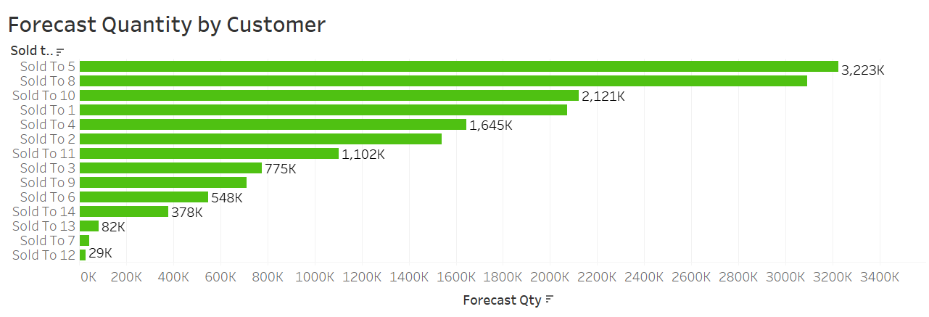
Forecast Insights
Top 3 Customer : 5、8、10

Slide 14
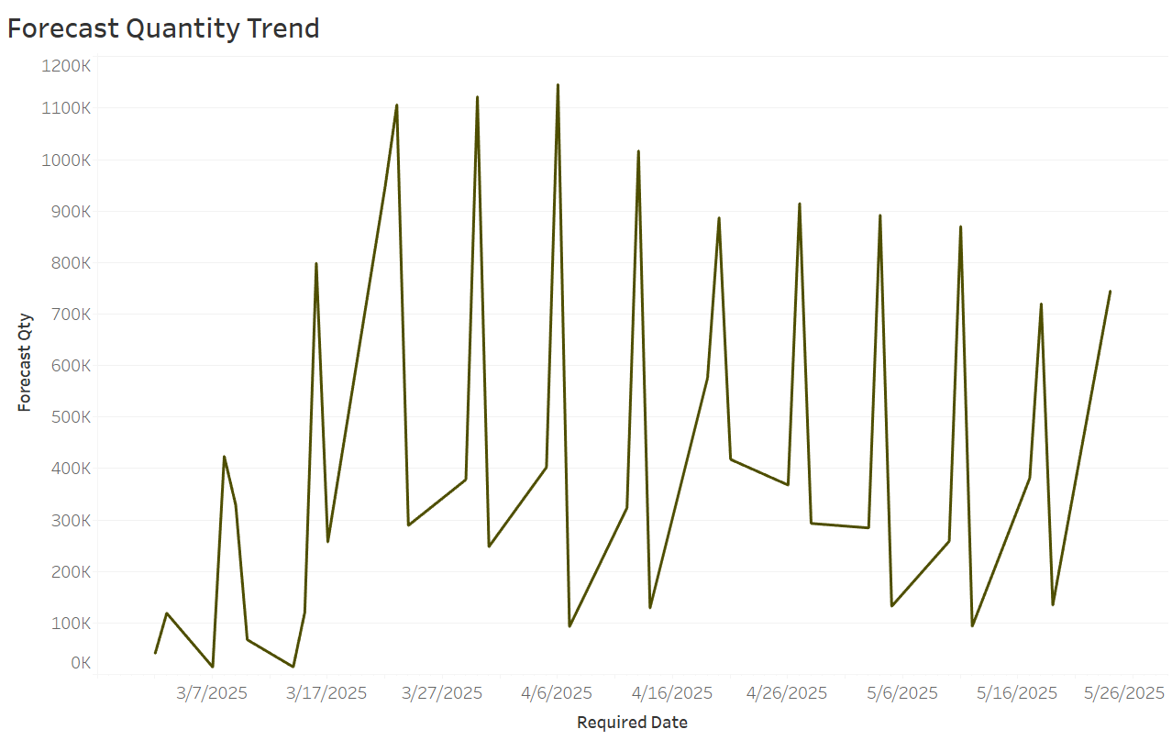
Forecast Insights
Forecast Quantity Trend
Peaks appear roughly every 5–7 days, suggesting a weekly cyclical pattern.

Slide 15
Model Selection

Slide 16
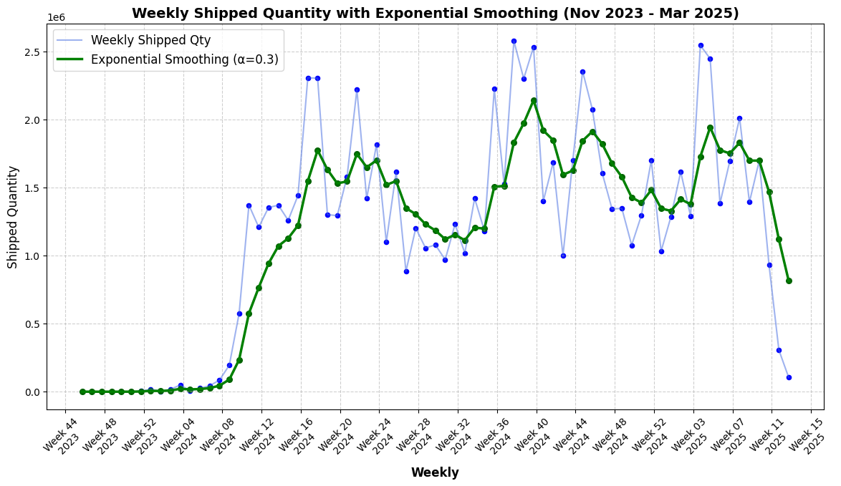
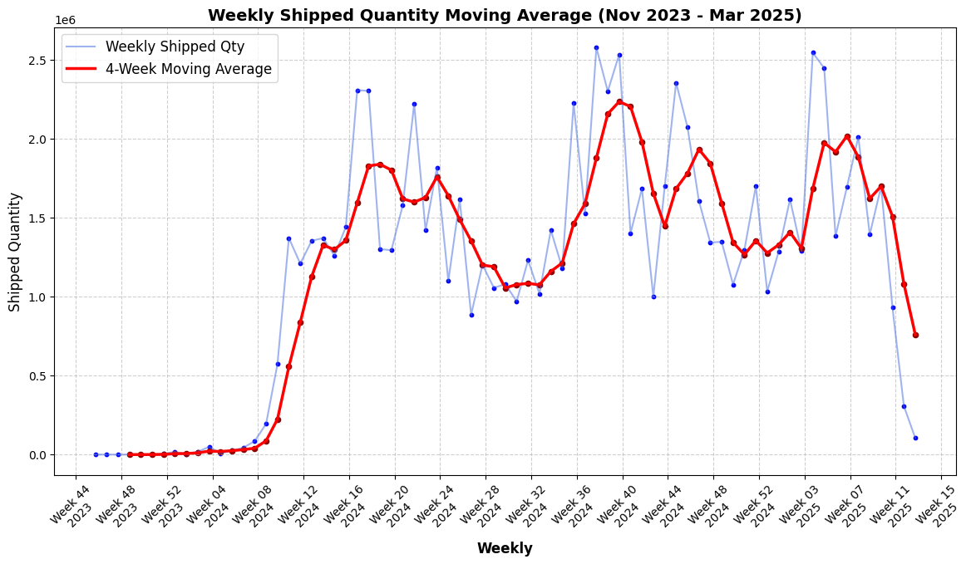
Exponential Smoothing
Understanding the Trend
non-linear
Exponential smoothing gives more weight to recent data.
Moving Average
The average of data points over a specific window of time,
Notes:
了解trend >線性還是非線性>選model
These smoothing methods help reveal the non-linear and fluctuating nature of our data, suggesting that a flexible, non-linear model would be more appropriate for forecasting.
We are showing weekly here is because we are predicting weekly
兩者不同之處
Moving average smooths data by averaging a fixed number of past periods equally, which gives a stable but slower response to changes. Exponential smoothing, on the other hand, assigns more weight to recent data, allowing the smoothed line to respond faster to recent changes.
Exponential smoothing better captures spikes and short-term fluctuations, while moving average smooths out more of the noise.

Slide 17
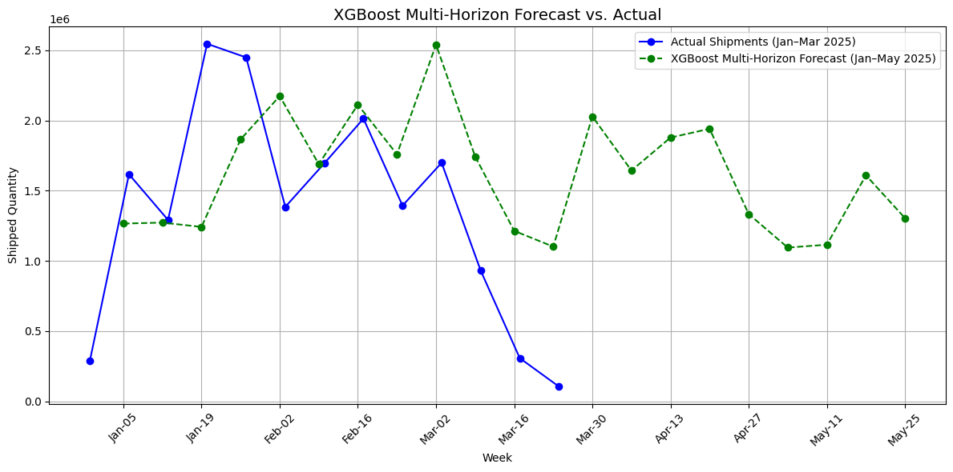
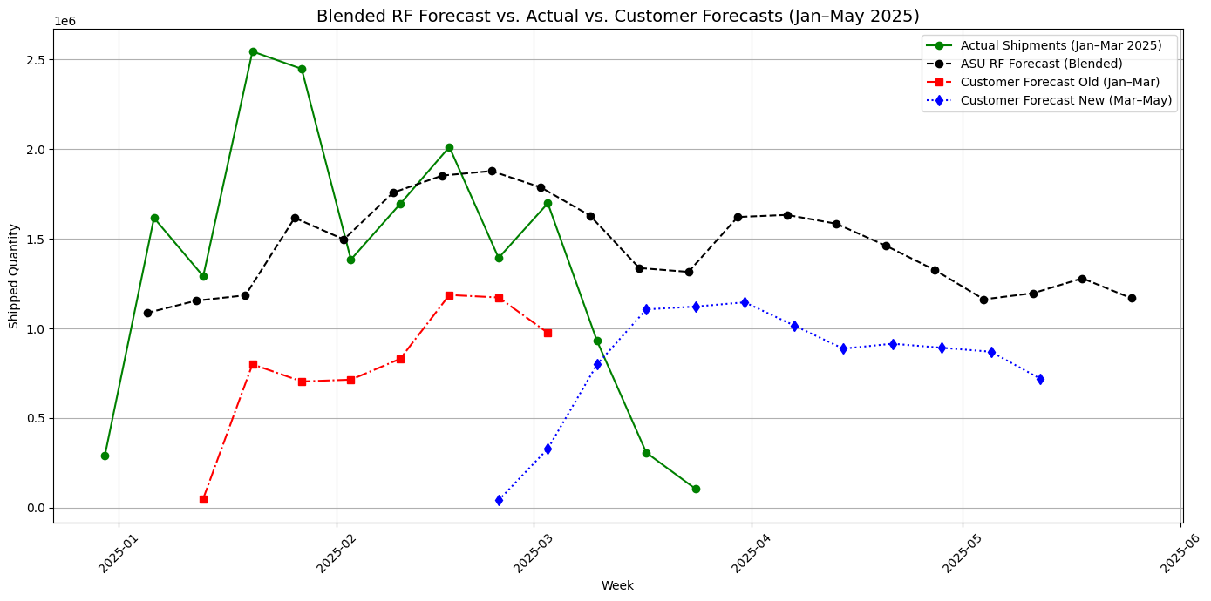
XGBoost Model
Random Forest
MAPE (Mean Absolute Percentage Error):
The average difference between forecast and actual, expressed as a percentage.
RMSE (Root Mean Squared Error)
The average size of the forecast error — larger errors are penalized more.
MAPE :2.0500
RMSE : 768,209.04
MAPE : 1.7535
RMSE : 704,709.63
We chose XGBoost over Random Forest because it better captures seasonal patterns and trends.
Notes:
XGBoost Capture the spikes
XGBoost was selected because it captures seasonality more effectively than Random Forest.
MAPE tells you the average error in percentage, while RMSE tells you how big the error is in actual numbers.

Slide 18
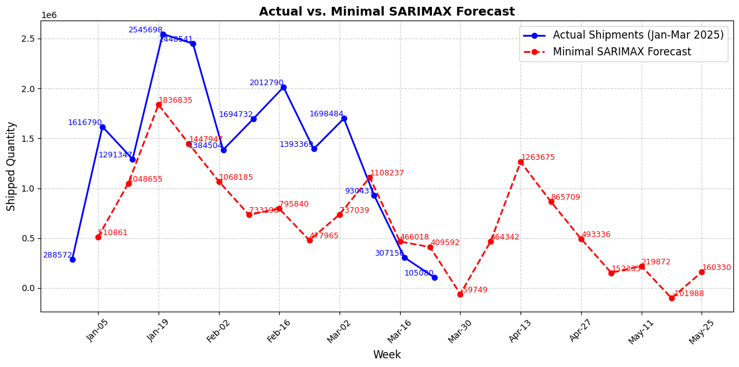
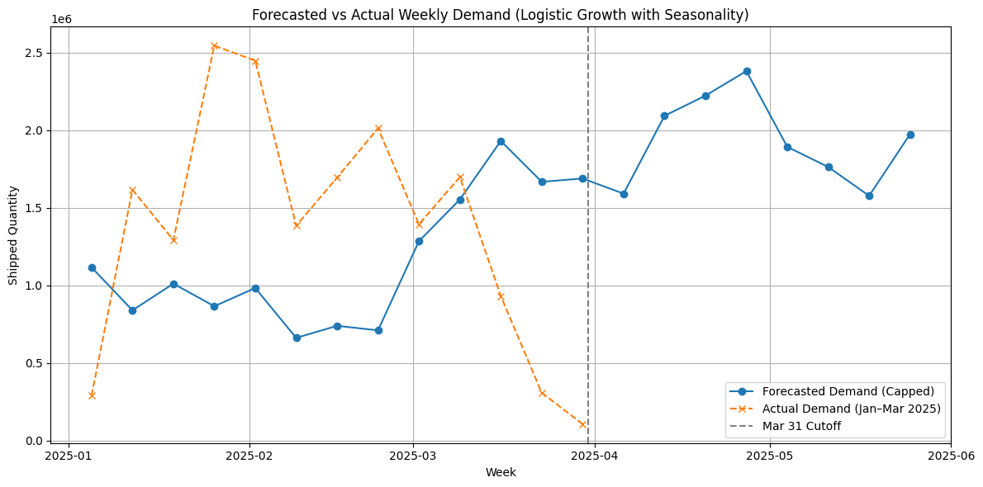
SARIMAX
Prophet
MAPE: 0.5786%
RMSE: 803,865.3422
MAPE: 209.98%
RMSE: 1,069,484
Due to limited training data, it fails to generalize future trends and produces mechanical, unrealistic patterns after March.
Flexible in trend modeling but overextended past trends due to limited data
Notes:
Best Minimal SARIMAX ModelMAPE: 0.5786
We also included SARIMA simply because it’s a well-known time series model, and we wanted to try it out as a baseline. Although we expected non-linear behavior in the data, we believed it was worth exploring how a traditional linear model would perform in comparison
Prophet可以說數字不好看，但也要知道為何會數字不好看，可能原因訓練不好的原因
Prophet 因缺乏多年資料參考、也未加入外部事件變數，導致它無法預期 2025 年初需求會下滑，而是持續延伸 2024 年的趨勢，造成預測結果與實際嚴重偏離。
SARIMA is likewise limited by the short training period, making it difficult to learn stable seasonality and trend patterns, which leads to delayed response to future fluctuations and decreased forecast accuracy.

Slide 19
Model

Slide 20
Shipment Forecast Overview (Jan-May 2025)
Objective:
Predict future shipment quantities based on historical patterns
Enhance production efficiency, optimize inventory levels, and streamline delivery and supply planning
Method:
Used past shipment data (2023–2024).
Forecast generated using XG Boost (a machine learning model).
XG Boost is an advanced machine learning tool that helps businesses make highly accurate predictions by combining multiple decision trees, improving decision-making and strategy planning.
Key Takeaways:
Forecast closely follows actual shipments for Jan–March 2025.
Forecast continues through May 2025 for proactive planning.

Slide 21
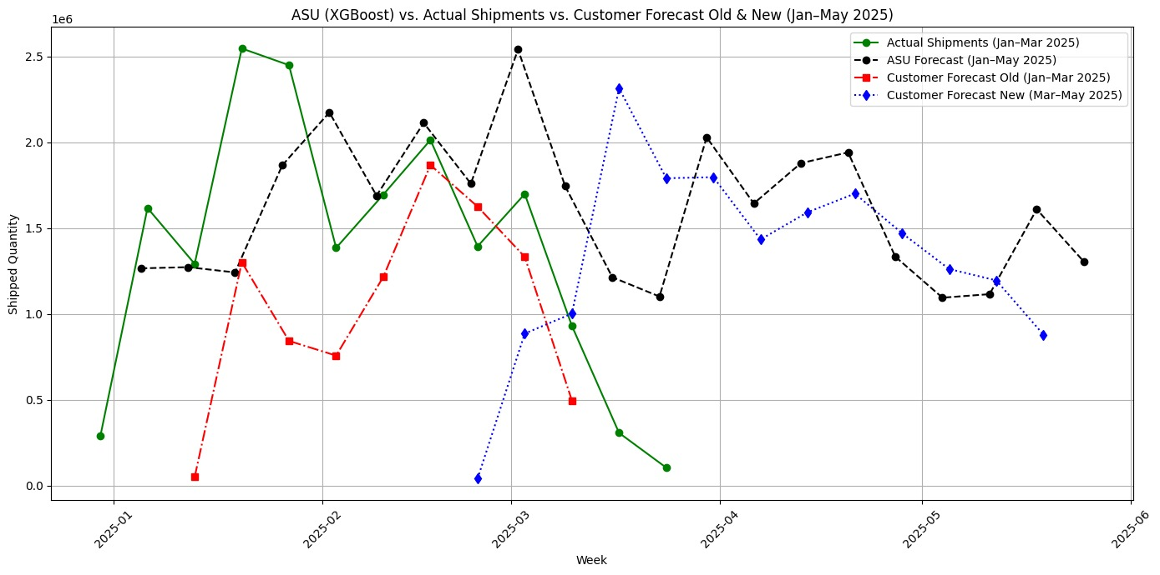
ASU XG BOOST VS ACTUAL SHIPMENT VS CUSTOMER FORECAST OLD & NEW(JAN-MAY2025)
Graph Insights:
ASU (XGBOOST) Forecast (black line) closely follows the actual shipments (green line) from Jan to March 2025
Customer old forecast (red line) significantly underestimate actual demand during Jan to March 2025
Customer’s New Forecast (blue line) underestimated actual demand during Jan to March 2025
ASU forecast remain stable and provides reliable planning guidance through May 2025

Slide 22

Demand Forecast Evaluation by Customer
Visual comparison of Customer Old Forecast, Customer New Forecast, ASU Forecast Model, and Actual Shipments customer wise.
Identified where forecasts were either: • Underestimating demand – too conservative, risking missed opportunities • Overestimating demand – too spiky or aggressive, difficult to act on • Or providing stable, reliable guidance – closely aligning with shipment trends
Clear variations in forecast behaviour across customers show the need for tailored forecasting strategies
This helps determine which approach is most dependable for business planning and execution

Slide 23
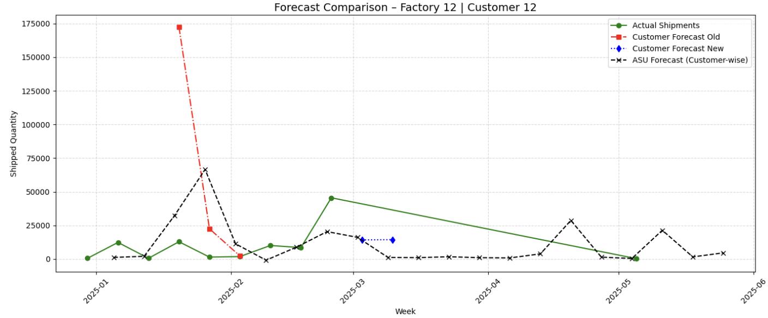
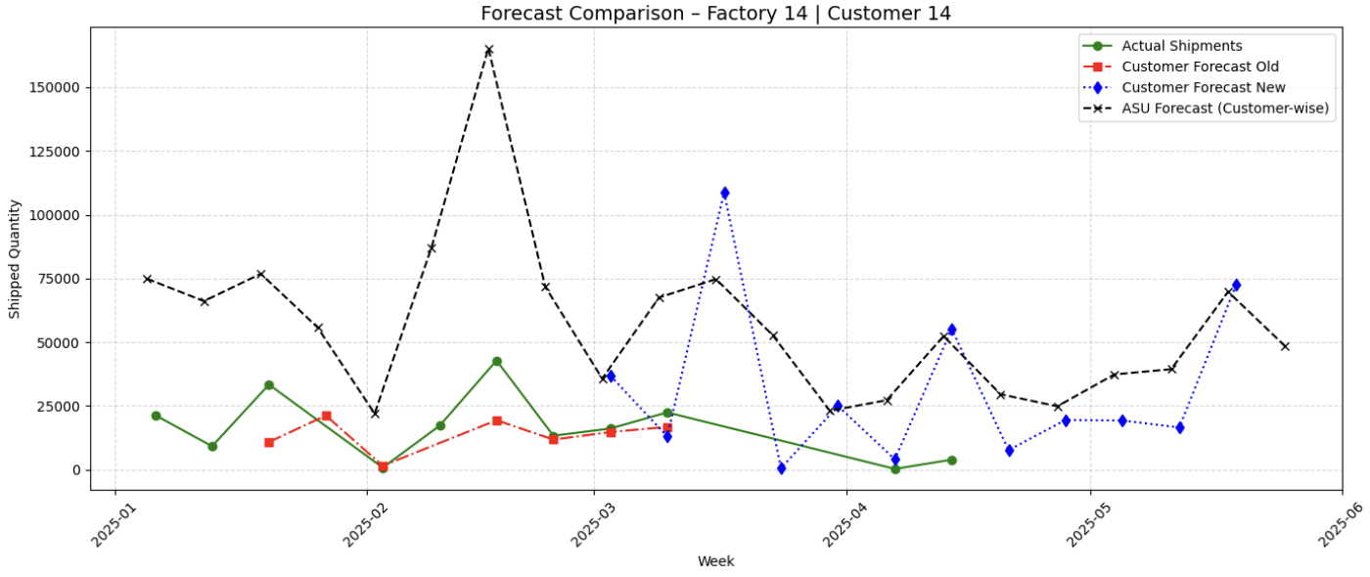
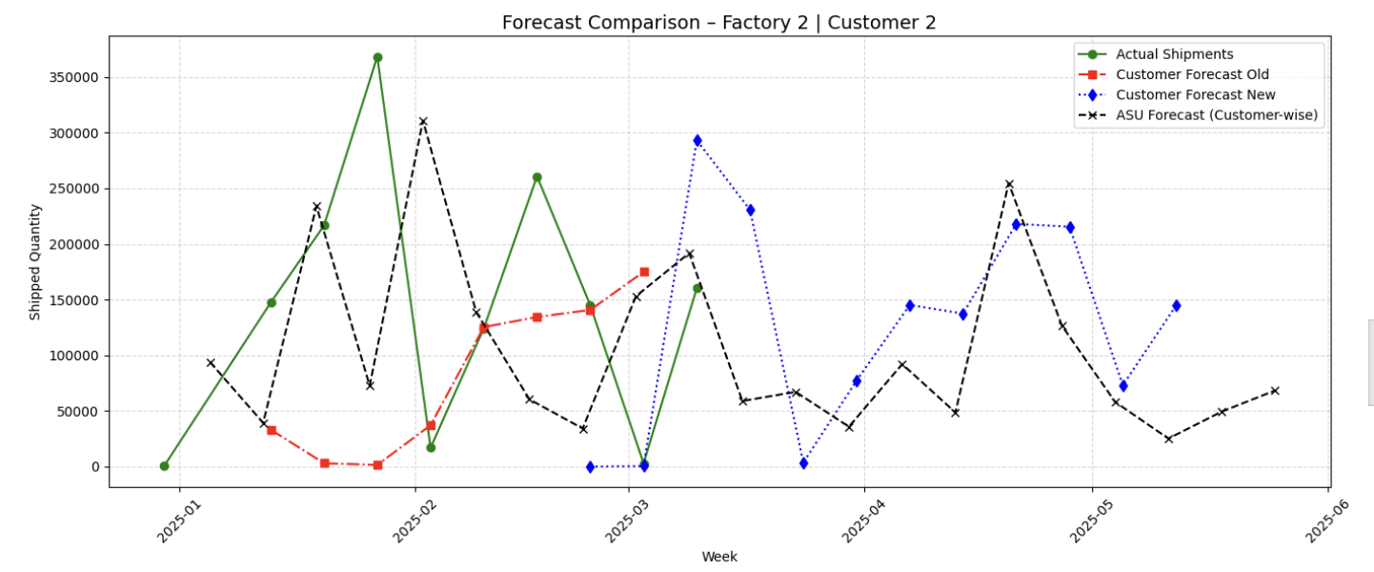
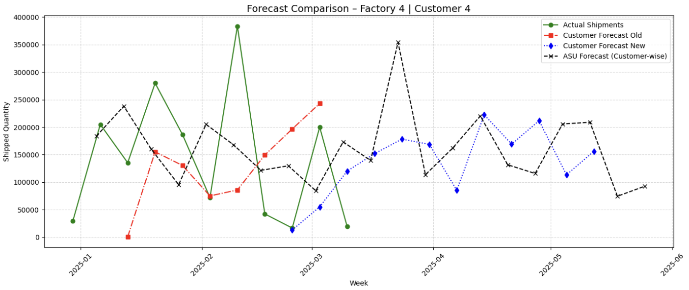

Slide 24
Demand Why Forecast Fluctuation Appears in Customer Trends
Clear difference in forecast stability between customers — some show consistent patterns, others are highly reactive
Demand fluctuations often driven by last-minute ordering, bulk shipment practices, or gap-filling behaviour from customers
Sharp peaks and drops in certain forecasts mirror actual business actions, not model bias
Fluctuations are higher where forecast inputs themselves are unstable or frequently revised
Highlights the importance of understanding customer-specific ordering behaviour when using forecasts for planning

Slide 25
Using NASDAQ Data in Avnet's Forecasting
NASDAQ reflects macroeconomic trends and investor sentiment in the tech sector, which can influence B2B electronic component distributors like Avnet.
A rise or fall in NASDAQ may indicate changing demand environments for tech-related hardware and components.

Slide 26
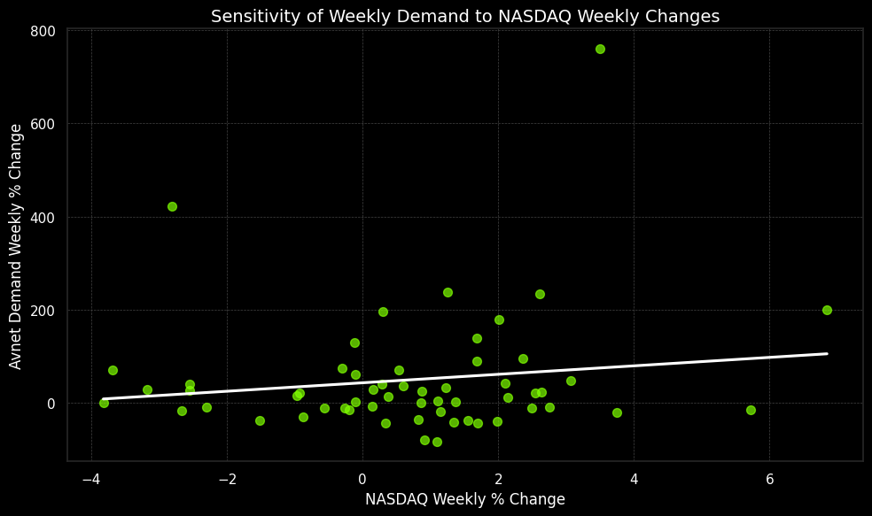
Evaluating NASDAQ’s Impact on Demand
No strong linear correlation was found between NASDAQ changes and Avnet’s weekly shipped quantities (high p-value).
This suggested NASDAQ is not a strong short-term predictor of Avnet’s weekly demand.

Slide 27
Why We Looked Deeper Into Market Trends
Long-Term Influence Possibility
Early Signal Monitoring
Market-Driven Demand Strategy

Slide 28
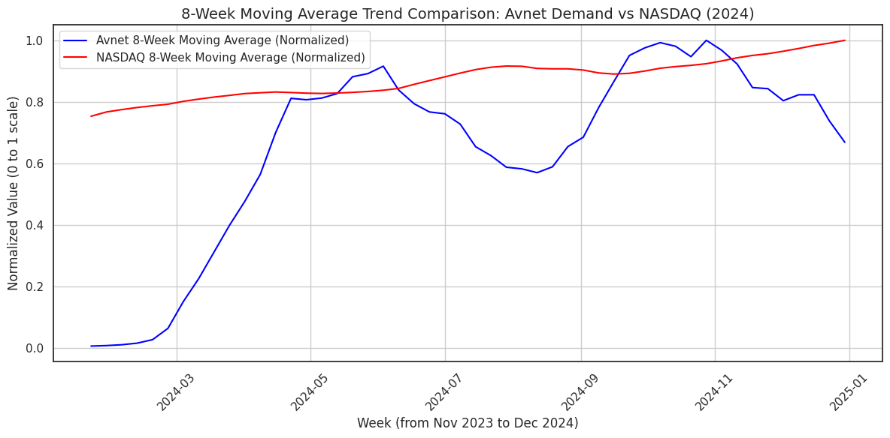
Smoothed Trend Analysis: Avnet Demand vs. NASDAQ (2024)
Avnet shows sharp swings, especially Feb–May and Sep–Nov.
NASDAQ trends upward smoothly with low volatility.
Demand and NASDAQ diverge mid-year, then briefly align in fall.
Short-term correlation is weak, confirming hypothesis test.

Slide 29
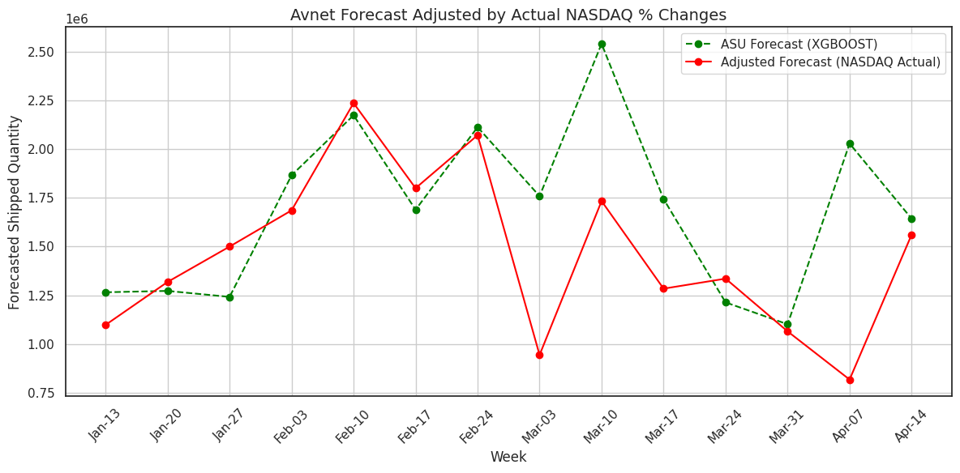
Forecast vs. NASDAQ-Adjusted Demand: A Comparative View
Green line shows the original XGBoost forecast from ASU model.
Red line is adjusted using actual NASDAQ weekly % changes.
Adjusted forecast reacts more sharply to market volatility.
NASDAQ dips (e.g., Mar 3 & Apr 7) cause visible forecast drops.

Slide 30
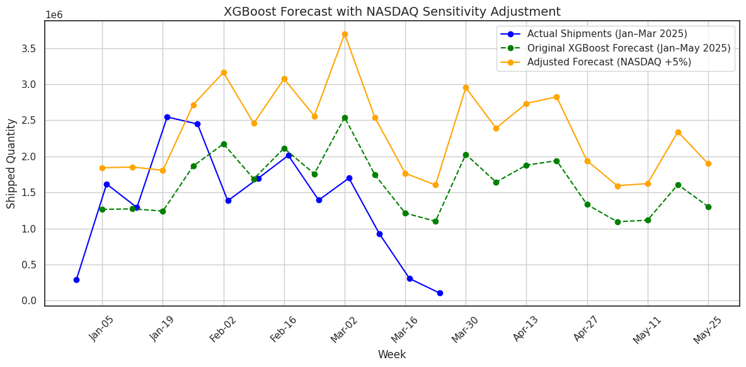
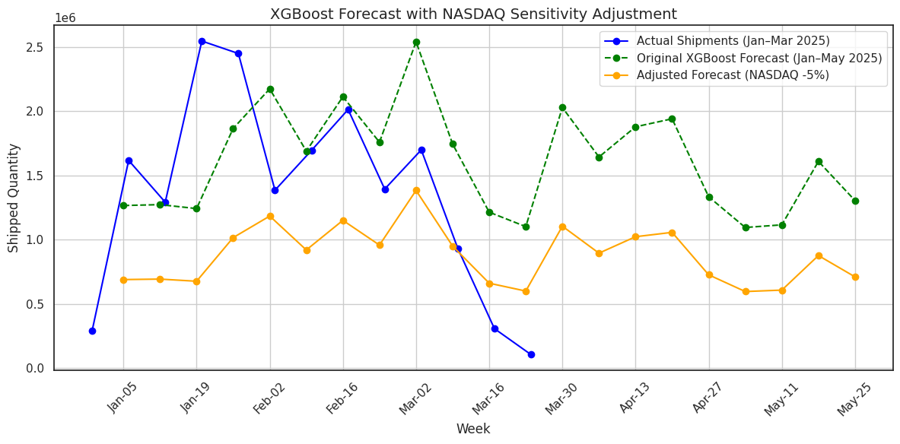
Scenario-Based Demand Forecasting Using NASDAQ Sensitivity
NASDAQ +5%
Orange Line: Forecast adjusted upwards assuming NASDAQ increases by 5%.
Forecasted demand shows a significant rise—reflects high sensitivity to bullish market sentiment.
Indicates potential over-preparation if market optimism doesn't materialize.
Useful for scenario planning and inventory buffering in optimistic market conditions.
NASDAQ -5%
Orange Line: Forecast adjusted downwards with a 5% drop in NASDAQ.
Demand projection shrinks substantially—shows how tech downturns could suppress distributor demand.
Highlights risk of underperformance in weak macroeconomic environments.
Helps in preparing risk mitigation strategies and demand shocks.

